Slide 1






Group Project
Tetris game
December 23, 2024

Slide 2


Team Members
Le Huynh Thien
ITCSIU23036
Doan Xuan Cao
ITITIU23004
Ly Gia Bao
ITDSIU23034

Slide 3

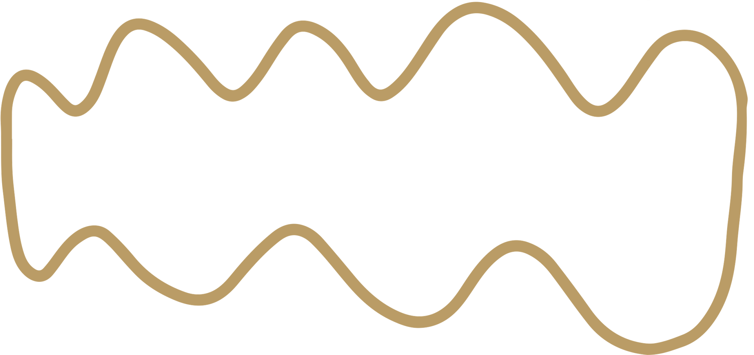
Tables of content
1
2
3
4
Abstraction
Class Diagram
UI Design
Conclusion

Slide 4

1. ABSTRACT
This project develops Tetris Game, which is a classic and widely recognized puzzle video game. The game revolves around the placement of geometric shapes, known as tetrominoes, onto a grid-based playfield.

Slide 5

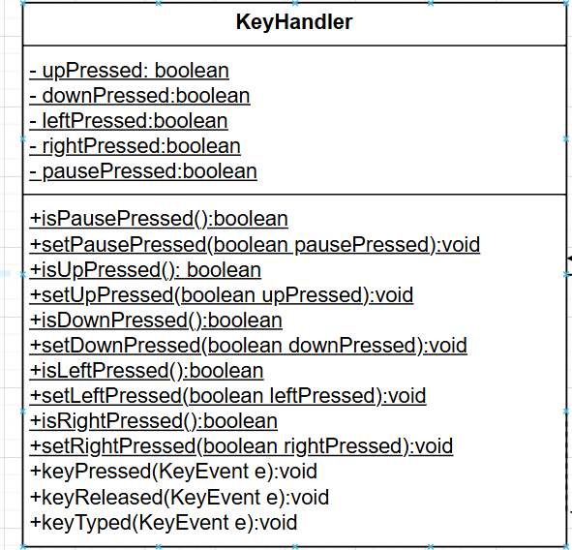

Class diagram
1. KeyHandler Class
The class ensures encapsulated access to input states and translates user actions into game events.
Notes:
The KeyHandler class serves as the system's interface for handling user input. It monitors key presses and releases, updating the state of relevant attributes that dictate gameplay actions.

Slide 6
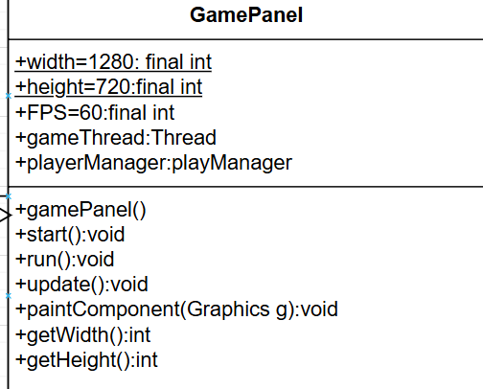
Class diagram
2.GamePanel Class
The GamePanel class serves as the core component of the graphical user interface (GUI). It is responsible for managing the game loop, rendering game components, and interacting with the gameplay logic encapsulated in the PlayManager class.

Slide 7
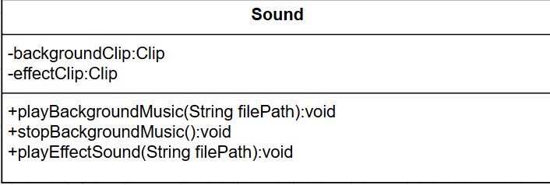
Class diagram
3.Sound Class
The Sound class centralizes audio management for the game, including background music and sound effects. By encapsulating audio playback logic, it simplifies the integration of sound into the game.

Slide 8
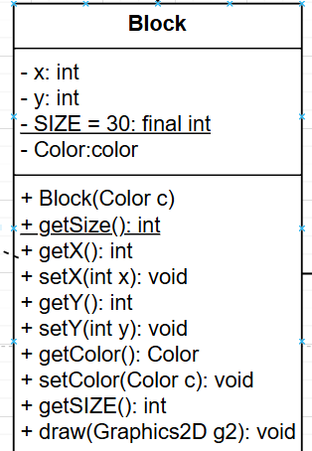
Class diagram
4.Block Class
The class encapsulates properties such as position, size, and color, and provides methods for rendering and updating blocks.
Notes:
The Block class represents the fundamental building block of all Tetris pieces. Each Tetris piece (Mino) is composed of multiple Block instances.

Slide 9
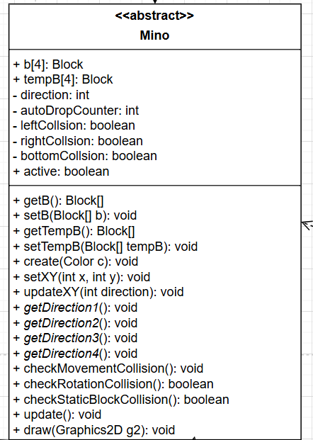
Class diagram
5.Mino Class
The Mino class represents a generic Tetris piece composed of multiple Block instances.
Notes:
It serves as the base class for all specific Tetris piece shapes (e.g., Mino_Bar, Mino_L1).

Slide 10
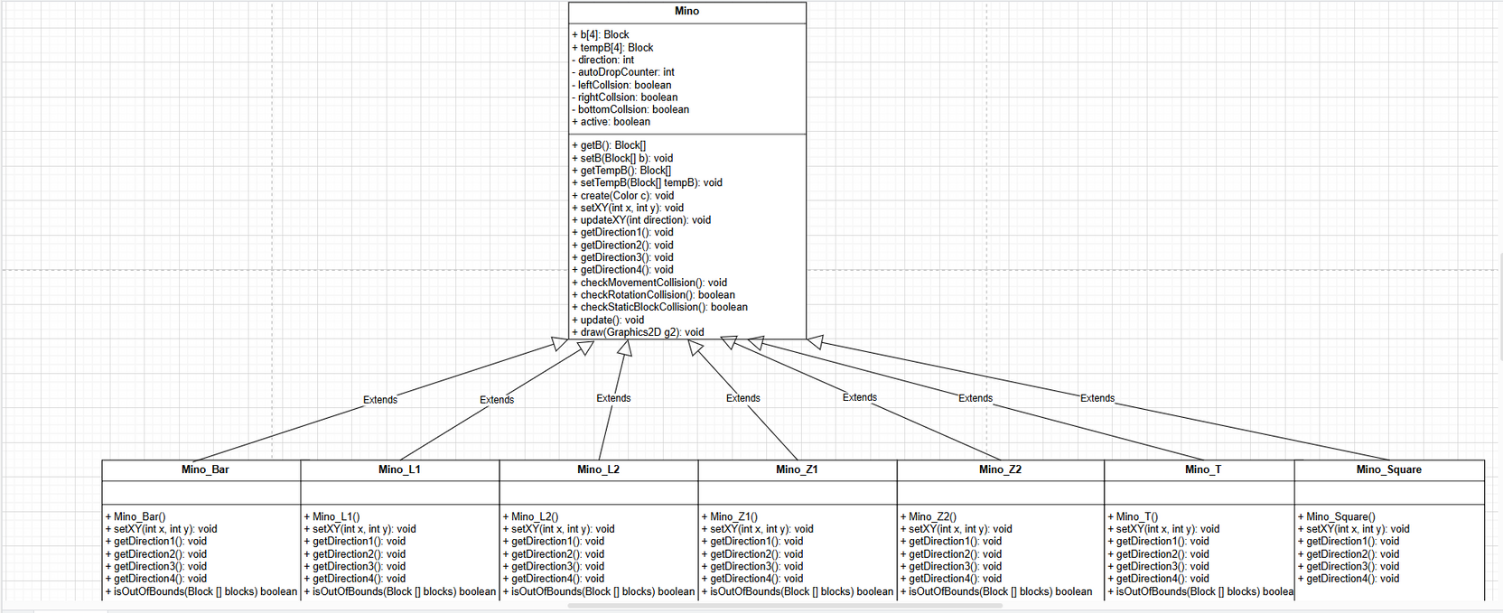
Class diagram
6. Mino Variants Classes
The Mino class is extended by specific subclasses that define the shapes and behaviors of individual Tetris pieces. Each variant inherits common attributes and methods from Mino but customizes the piece layout and behavior.

Slide 11
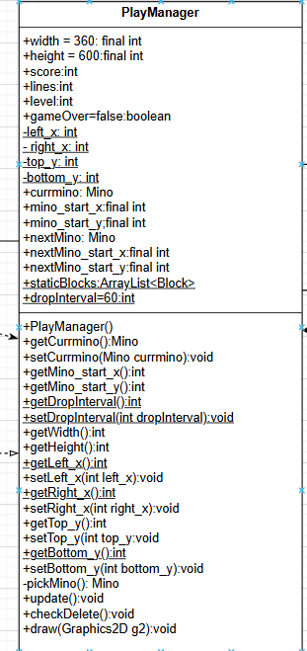
Class diagram
7. PlayManager Class
The PlayManager class manages the core gameplay mechanics.
Notes:
It is responsible for handling active and upcoming Tetris pieces, detecting and resolving collisions, managing static blocks, and clearing completed lines.

Slide 12
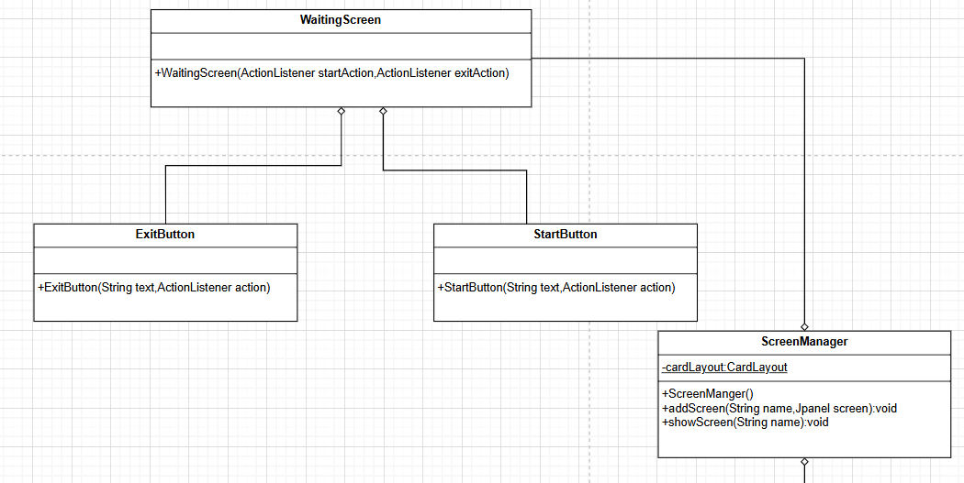
Class diagram
8 User Interface Classes
The User Interface (UI) classes are responsible for creating and managing the visual components of the Tetris game. They enable players to interact with the game through well-defined controls (buttons) and structured screens, ensuring a seamless and engaging user experience.

Slide 13
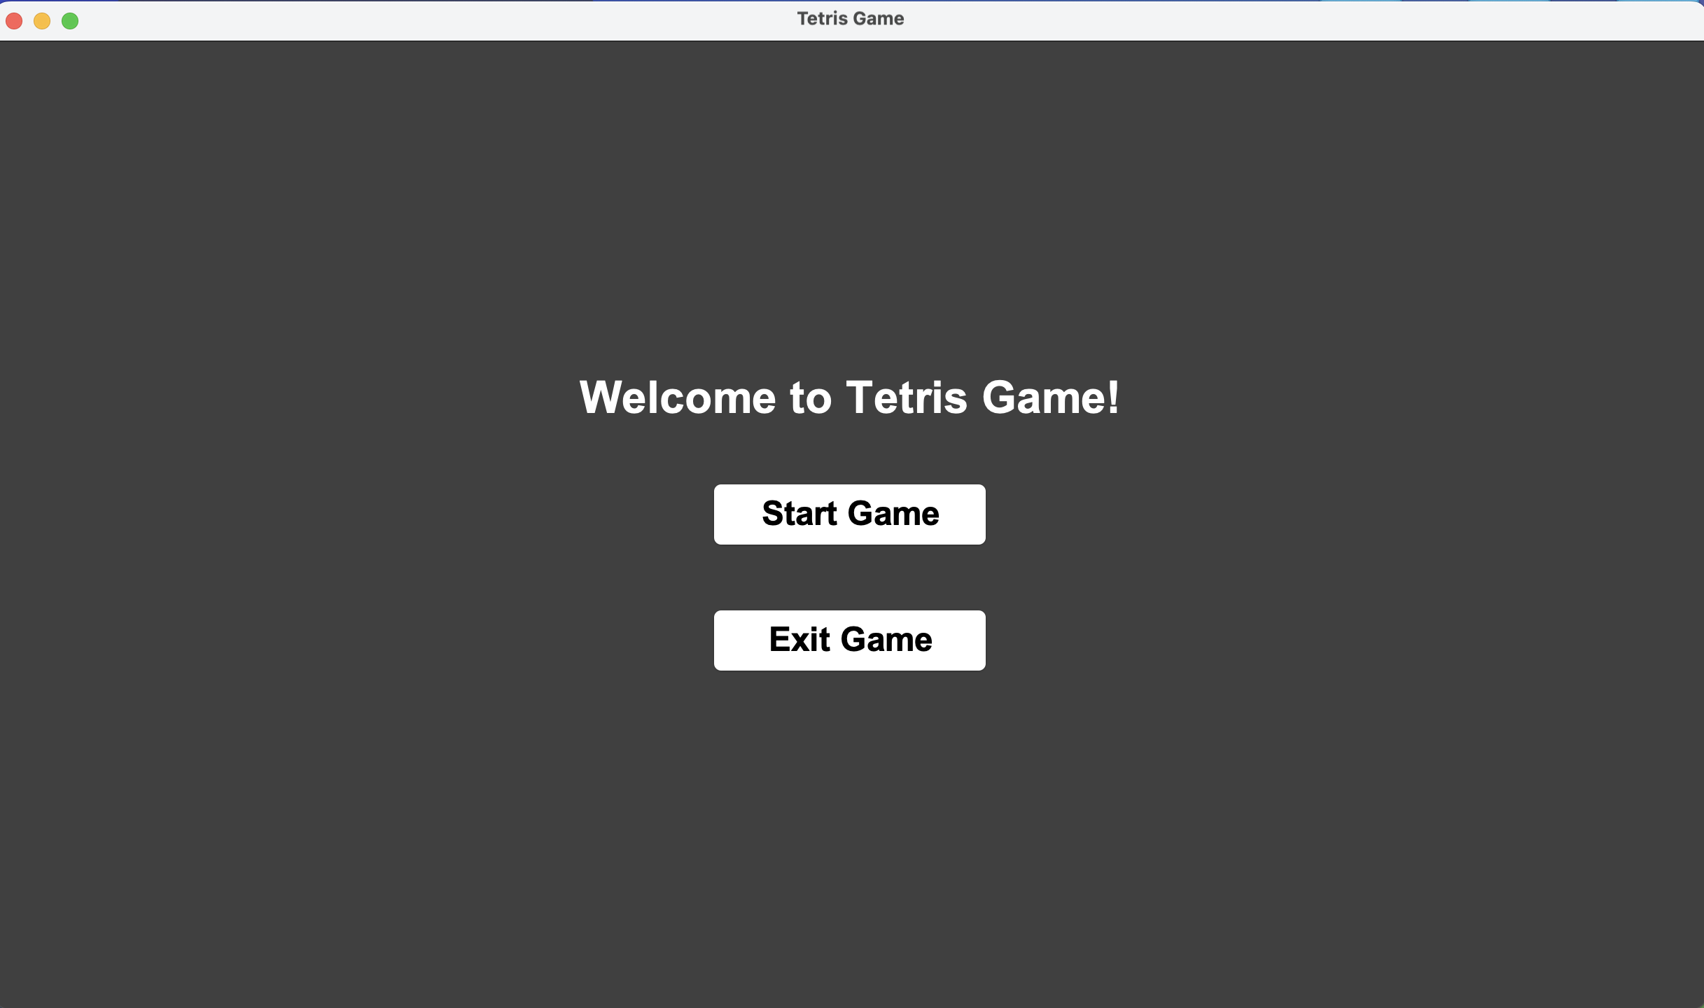
User Interface Classes
Waiting Screen
StartButton: Start the game with visually distinct styling and functionality
ExitButton: Provide an easy and clear way to exit the game.
WaitingScreen: Serve as the initial interaction hub, orchestrating navigation through buttons
The ScreenManager listens for user actions from UI components such as StartButton and ExitButton

Slide 14
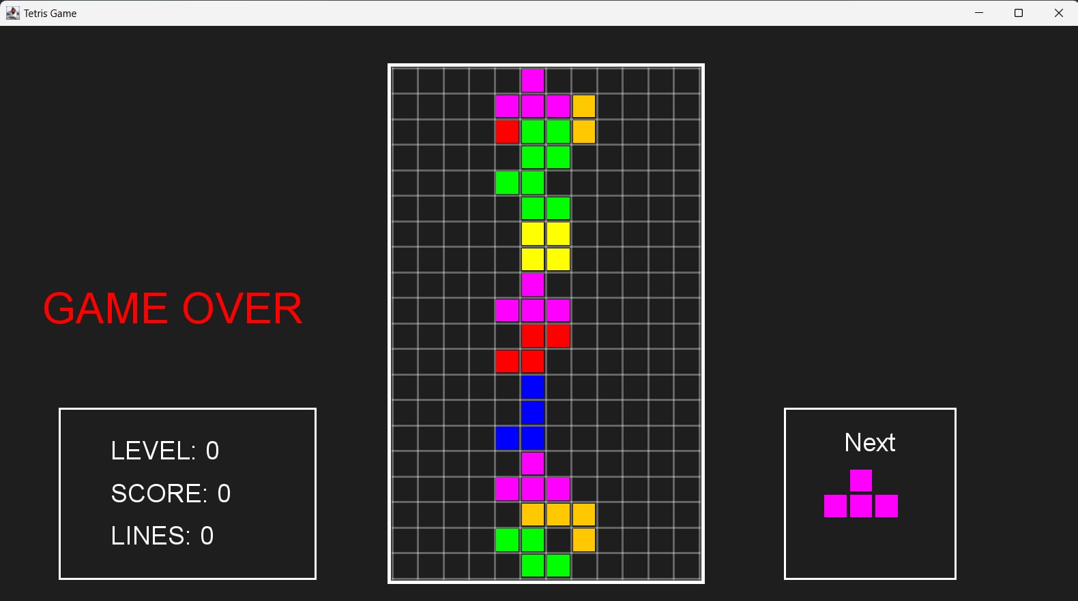
User Interface Classes
Main Screen
Start: The game initializes and waits for the player to start.
Gameplay:
- The active piece is controlled by the player.
- Rows are cleared, scores are updated, and levels progress.
- The game increases in difficulty as the player clears more lines.
Pause/Game Over:
- Pause: Halts gameplay and waits for the player to unpause.
- Game Over: Stops updates and waits for the player to reset.
Reset: The game is reset, allowing the player to start a new session.

Slide 15


Features and Implementation
1. Scoring and Level Progress System
Score Calculation:
50 points are awarded for each cleared line.
Speed Adjustment:
Drop speed reduces by 10 or 1 frame based on the level progression.
Level Progression:
The level increases every 5 lines cleared.
Each level increment reduces the Tetrimino drop interval, making the game faster.

Slide 16
Features and Implementation
2. Sound effects and music
Background Music:
Plays a continuous loop of background music during gameplay.
Stops the music when the game is paused or over.
Sound Effects:
Provides one-time sound effects for game events, such as clearing a line or pressing a button.
Ensures sound effects do not overlap by stopping the previous clip before playing a new one.
Dynamic Playback Control:
Allows starting, stopping, and looping audio files.

Slide 17


Conclusion
Game Functionality:
The core mechanics of Tetris, including piece generation, rotation, movement, and line clearing, were implemented effectively.
Collision detection was handled to ensure seamless gameplay.
2.User interface
3.OOP Design Principles
4.Game Logic and Mechanics

Slide 18
THANK YOU

